Slide 1
Skills that Killz: From Network to Cloud Engineer
Presented by Craig Johnson

Slide 2
About the Presenter
On prem network engineer for way too long🌐
Operations, architecture, post sales, pre-sales, etc
8 years at the mothership in post sales
Mostly a CLI junkie
Built way too many labs/studied for certifications building topologies physically and in EVE-NG/GNS
Why cloud computing? 🌥️
I started about 2.5 years ago
Arrived from a need at current employer
New thing to learn!
What did I learn along the way? Turns out, it’s a lot of fun!
Preso and code from tonight at github.com/fracticated/txnug

Slide 3
Training and Certification - Learn by Doing!
Learn by Doing 📚 – get started tonight!
The best way to learn cloud engineering is by doing hands-on exercises and projects.
Focus on just the networking pieces
Cloud Training Options 🌥️
Good for the basics, things change too fast
A Cloud Guru and Udemy courses are good if you need video content – not really my style
Next up – what does the cloud look like? How is it similar to on prem?

Slide 4
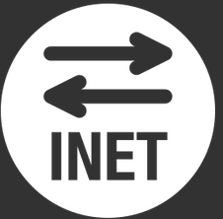
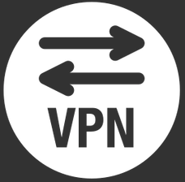

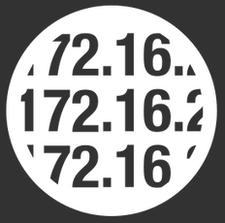


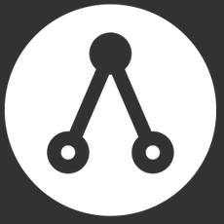
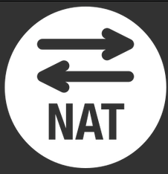

To internet
To on-prem VPN
To on-prem via
dedicated circuit
VPC
To on-prem VPN
VPC-peering:
to other VPCs
To other TGW
Network ACL
Security Group
To other VPCs

Slide 5
IaC - Your Cloud Engineering Superpower
Don’t do what I just did!!!!!
Don’t create resources with the cloud console!!!!
It creates bad habits that are REALLY hard to break
Infrastructure as Code (IaC) - the key to cloud mastery! 🔑
Define, provision, and manage infrastructure using code 📝
Improve consistency, repeatability, and version control ⚙️
Will save you money – only deploy when you need, destroy when you are finished🤝
Terraform, CloudFormation, and more - pick your weapon! 💪
Terraform - multi-cloud provisioning with HashiCorp's tool 🌐
AWS CloudFormation - native AWS infrastructure automation 🌩️
Azure Resource Manager (ARM) templates - Microsoft's IaC solution 🔷
Automate, scale, and adapt with IaC - the cloud's secret sauce 🚀
Easily scale up or down to meet changing demands 📈
Adapt to new cloud technologies and services effortlessly 🌠
Already have a cloud? Use https://github.com/GoogleCloudPlatform/terraformer to turn into Terraform

Slide 6
IaC - Your Cloud Engineering Superpower
Infrastructure as Code (IaC) - the key to cloud mastery! 🔑
Define, provision, and manage infrastructure using code 📝
Improve consistency, repeatability, and version control ⚙️
Enhance collaboration across teams and reduce manual errors 🤝
Terraform, CloudFormation, and more - pick your weapon! 💪
Terraform - multi-cloud provisioning with HashiCorp's tool 🌐
AWS CloudFormation - native AWS infrastructure automation 🌩️
Azure Resource Manager (ARM) templates - Microsoft's IaC solution 🔷
Automate, scale, and adapt with IaC - the cloud's secret sauce 🚀
Accelerate deployments with automated provisioning 🏎️
Easily scale up or down to meet changing demands 📈
Adapt to new cloud technologies and services effortlessly 🌠

Slide 7
IaC vs. Configuration Management
Infrastructure as Code (IaC) - Provisioning with Code 📝
IaC tools like Terraform and CloudFormation are used to define and deploy infrastructure resources in a consistent, repeatable manner.
IaC focuses on defining and provisioning the infrastructure layer of a cloud deployment, including servers, networks, and storage.
Configuration Management - Managing Software 🧰
Configuration management tools like Ansible and Chef are used to manage the software layer of a cloud deployment.
Configuration management focuses on maintaining and configuring the software running on top of the infrastructure layer, such as operating systems, applications, and middleware.
Key Differences 🔑
IaC is focused on defining infrastructure resources and deploying them in a repeatable, consistent manner.
Configuration management is focused on managing software and maintaining its configuration across multiple machines.
IaC is used for infrastructure changes, while configuration management is used for software changes.
IaC tools provision infrastructure from scratch, while configuration management tools configure and manage existing infrastructure.

Slide 8
Connecting Your Cloud Setup to Your Home Lab
Secure Connectivity is Key 🔒
Connecting your cloud environment to your home lab requires secure and reliable connectivity.
Improve consistency, repeatability, and version control ⚙️
VPNs can be established directly to your lab router – config already provided!
Static IP Requirement 💻
You will need a static IP on your home lab. Routing is either BGP or static
If your home network doesn't have a static IP, you can use a VPN service like PureVPN to obtain one (although with some speed penalties). Be sure to choose one that uses IKE/IKEv2!
You can also use the automation previously shown to dynamically provision the IP
Integrate other automation technologies🚀
Call device configuration scripts with terraform🏎️
Call ansible with terraform📈
Use new providers like vsphere, docker, etc to provision other components🌠
Benefits of Connecting Your Home Lab to the Cloud 🚀
Natively access your cloud environment securely from your home network – no NAT or gateways
Use your home lab as a test environment for cloud deployments.

Slide 9
Get Building!
Setup free tiers on your cloud of choice
Using terraform/IaC will save you loads of money
But look at cost estimators if you start moving lots of traffic
Don’t be afraid to break anything 💻
Its all a “terraform destroy” away
ChatGPT is your best friend with building scripts
Start small – ask for something simple (“Give me a terraform script to build a VPC”) and then build on to it
If it goes wrong, just paste the error message in
Have fun! Its always changing and very rewarding to learn.

